Slide 1
NAVIGATING
CHANGE
Unpacking the Impacts of the GPA on Transitional Economies
Presented By: Xinyue Xue
Start Slide

Slide 2
At a Glance
Xinyue Xue is a PhD Candidate in Law at the University of Birmingham, UK. She is also a Marie Sklowdoska-Curie early-stage researcher at the SAPIENS Network.
Her research focuses on the various legal and policy instruments to empower small and medium-sized enterprises in public procurement from a comparative law and economics perspective. She is also a visiting scholar at George Washington University Law School, researching small business policies in the US federal procurement rules.

Slide 3
AGENDA
Introduction to the GPA and the qualitative impacts
A Methodology for Quantitative Impact Assessment before Accession

Slide 4
GPA’S COMPONENTS AND AIM
“To ensure open, fair and transparent conditions of competition in the government procurement markets, a number of WTO members have negotiated the Agreement on Government Procurement (GPA).”
Text of the Agreement
Parties’ market access schedules of commitments
Non-discrimination
Transparency
Procedure fairness
Mutually open government procurement markets among its parties

Slide 5
Improved Transparency,
Good governance
Enhanced competition
Potential improved value for money
Procurement System
Public Buyers
Qualitative impacts
IMPACTS OF GPA
Legal System
Quantitative impacts
Domestic Suppliers
Regional/ international harmonisation of procurement rules
Potential export gains
More predictability rules and remedies

Slide 6
A METHODOLOGY FOR
ASSESSMENT BEFORE ACCESSION
Impacts of GPA
Legal system
Economy
Improved Transparency
Increased competition
Estimated Export Gains
Estimated procurement Savings
Compliance with the GPA Text
Eliminated favouritism

Slide 7
A METHODOLOGY FOR
ASSESSMENT BEFORE ACCESSION
Identify the laws, policies, and practices relating to national procurement that must be changed to comply with the GPA text.
The WTO’s Checklist of Issues for Provision of Information Relating to Accession to the Revised Agreements on Government Procurement GPA/132 (14 October 2015)
The OECD taxonomy of measures affecting trade in government procurement processes (02 Mar 2017)
STEP 1
Where to find?
Define the GPA Accession Scenario
Source: PUTTING NUMBERS ON ACCESSION TO THE WTO’S AGREEMENT ON GOVERNMENT PROCUREMENT: A RECIPE BOOK APPROACH, Simon J. Evenett, 2018

Slide 8
A METHODOLOGY FOR
ASSESSMENT BEFORE ACCESSION
The value of goods (also services, works) purchased by state bodies that are above standard GPA thresholds (also expressed as a percentage of the total value of all goods purchased).
Express the range of potentially contestable government procurement spending as a percentage of GDP and compare it to the total share of existing imports in GDP.
Where to find?
Utilize UN COMTRADE, WTO Trade Profile, and GPA members' procurement databases.
STEP 2
Estimate of Own Procurement Covered
WTO Integrated Government Procurement Market Access Information (e-GPA) portal
Source: PUTTING NUMBERS ON ACCESSION TO THE WTO’S AGREEMENT ON GOVERNMENT PROCUREMENT: A RECIPE BOOK APPROACH, Simon J. Evenett, 2018

Slide 9
1. Identification Strategy
A Methodology for
Impact Assessment before Accession
Design an econometric identification strategy based on the timing and products and services covered by a transparency improvement or non—discrimination improvement in procurement rules.
2. Detect the intervention
Requires a reform (in procurement rules) that happened in this country on transparency (non-discrimination); detailed tender information before and after this intervention.
STEP 3
3. Potential Variables
Call for tender publication rate; missing information rate; Winning price; foreign bidder rate; foreign contractor rate.
Estimate of improved transparency and eliminated favouritism
Source: PUTTING NUMBERS ON ACCESSION TO THE WTO’S AGREEMENT ON GOVERNMENT PROCUREMENT: A RECIPE BOOK APPROACH, Simon J. Evenett, 2018

Slide 10
A Methodology for
Impact Assessment before Accession
How to Estimate Improved Transparency and Favouritism?
A Simplified Example
A basic linear regression model to estimate the effect of transparency changes on winning bid prices
Winning Bid Price = β0 + β1 * TransparencyChange + β2 * ControlVariable1 + β3 * ControlVariable2 + ε
A positive β1 suggests improved transparency led to higher bid prices, while a negative β1 suggests lower prices.
Evaluate the economic significance of the coefficient β1 to understand how much transparency changes impact winning bid prices in practical terms.

Slide 11
A METHODOLOGY FOR
ASSESSMENT BEFORE ACCESSION
Estimate a difference in differences model where treatment timing derives from the entering into force of a new rule and control group is represented by those tenders which fall under the contract value thresholds.
Potential indicators:
Single bidding number
Number of bidders
Percentage of foreign bidders
Percentage of foreign contractors
Sources
Contract-level data, among others, including data on the number of bidders, the ID and country of registration of bidders and suppliers, the country of origin of owners of bidders and suppliers
STEP 4
Estimate increased competition
Source: PUTTING NUMBERS ON ACCESSION TO THE WTO’S AGREEMENT ON GOVERNMENT PROCUREMENT: A RECIPE BOOK APPROACH, Simon J. Evenett, 2018

Slide 12
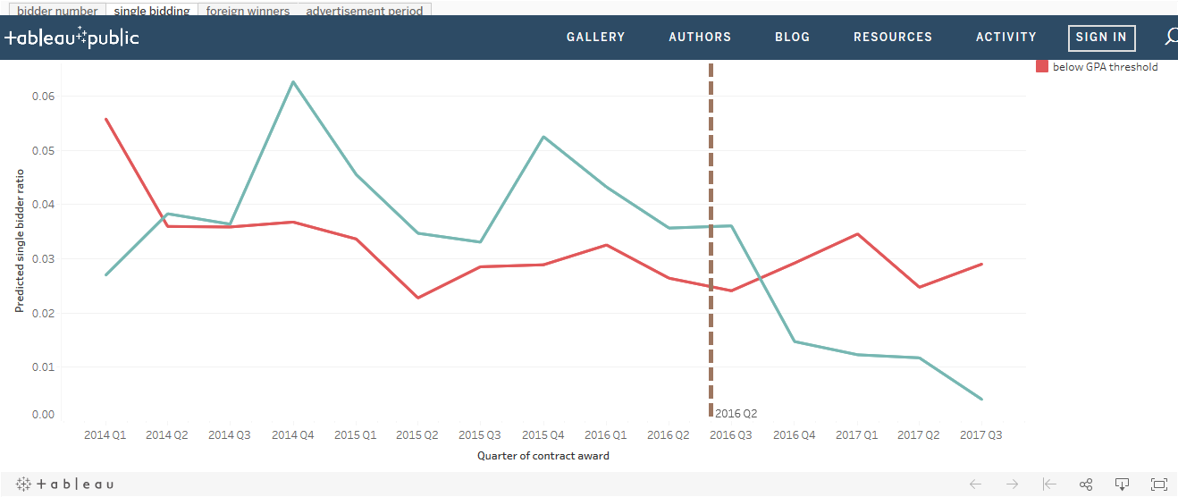
STEP 4
A METHODOLOGY FOR
ASSESSMENT BEFORE ACCESSION
An example
Sources:
https://public.tableau.com/profile/mihaly.fazekas#!/vizhome/WTO-GPA-IEMoldovapilot/biddernumber
Notes:
Case study on Moldova post-accession assessment by Mihaly

Slide 13
A METHODOLOGY FOR
ASSESSMENT BEFORE ACCESSION
Quantify export gains from GPA accession by identifying key products, estimating purchases by GPA members, and assessing the potential market share increase.
1 - Product Identification
2 -Market Size Estimation
3 - Export Growth Calculation
Where to find?
Utilize UN COMTRADE, WTO Trade Profile, and GPA members' procurement databases.
STEP 5
Estimate Export Gains
Source: PUTTING NUMBERS ON ACCESSION TO THE WTO’S AGREEMENT ON GOVERNMENT PROCUREMENT: A RECIPE BOOK APPROACH, Simon J. Evenett, 2018

Slide 14
A METHODOLOGY FOR
ASSESSMENT BEFORE ACCESSION
Estimated procurement savings
% tenders contested by foreign firms *
% cost reduction when foreign firms contest tender *
Total value of procurement exceeding GPA thresholds
Scenario Analysis
Explore different scenarios with varying foreign firm contestation percentages (1%, 3%, 5%, 10%, 20%) and cost reductions (10%, 25%, 50%).
Calculate estimated procurement savings for each scenario.
Scale savings by national GDP.
STEP 6
Savings Calculations
Estimate Procurement Savings
Scaling
Source: PUTTING NUMBERS ON ACCESSION TO THE WTO’S AGREEMENT ON GOVERNMENT PROCUREMENT: A RECIPE BOOK APPROACH, Simon J. Evenett, 2018

Slide 15
A METHODOLOGY FOR
ASSESSMENT BEFORE ACCESSION
Article 5 Paragraph 3
“Based on its development needs, and with the agreement of the Parties, a developing country may adopt or maintain one or more of the following transitional measures, during a transition period and in accordance with a schedule...”
a) a price preference programme
b) an offset
c) the phased-in addition of specific entities or sectors
d) a threshold that is higher than its permanent threshold
STEP 7
Transitional Measures or Exclusions
Source: PUTTING NUMBERS ON ACCESSION TO THE WTO’S AGREEMENT ON GOVERNMENT PROCUREMENT: A RECIPE BOOK APPROACH, Simon J. Evenett, 2018

Slide 16
1. Identify
Products/services that might face heightened competition
internationally contestable procurement exceeds 20%;
import tariff rate below 15% and no non-tariff barriers
TRANSITIONAL MEASURES OR EXCLUSIONS
2. Create
A “List of Potential Concerns”
3. Calculate
Diving Deeper into Step 7
The share of annual procurement above GPA thresholds that falls within the "List of Potential Concerns”
4. Determine
The minimum threshold for each good on the list
5. Draw
Initial conclusion on transitional measures
Source: PUTTING NUMBERS ON ACCESSION TO THE WTO’S AGREEMENT ON GOVERNMENT PROCUREMENT: A RECIPE BOOK APPROACH, Simon J. Evenett, 2018

Slide 17
Indicators Adopted in this Methodology
 | Indicators | Aim
Estimate Improved Transparency and Eliminated Favouritism | Number of foreign bidders Percentage of foreign bidders Winning bid price Measures of bidder competitiveness based on the relationship between bid prices and the estimated or reserve price set by the procuring entity | Use econometric analysis to estimate potential effects of improved transparency/eliminated favoritism
Estimate increased competition | Number of bidders Percentage of foreign bidders Percentage of foreign contractors | To calculate the increased competition induced by the accession to the GPA and related change of procurement rules
Estimate procurement savings | Tender-by-tender data of the accession country’s procurement GDP of the accession country Total value of public procurement exceeding the relevant GPA threshold Total value of public procurement of the accession country | Calculate the percentage of the procurement which will be covered by GPA; Calculate the potential procurement savings due to GPA accession
Estimate Export Gains | Total exports of the accession country Total purchases of GPA members Total purchases of GPA members from foreign suppliers | Calculate the percentage increase in the accession country’s total exports if the country can get 1 % of the GPA members’ purchases

Slide 18
OPEN CONTRACTING DATA STANDARD (OCDS)
The OCDS enables the disclosure of data and documents at all stages of the contracting process by defining a common data model.
It was created to support organizations to increase contracting transparency, and allow deeper analysis of contracting data by a wide range of users. It provides a common ground for different e-procurement systems

Slide 19
Mapping indicators in OCDS
An example
Step 4: Estimate Increased Competition
 | Indicators | OCDS fields
 | Number of bidders (average, median, and single bidding); | tender/tenderers (object, array)
 |  | tender/numberOfTenderers
 | Percentage of foreign bidders (registered or owned abroad: regional/European/global); | tender/tenderers/address/countryName
 | Percentage of foreign suppliers (registered or owned abroad: regional/European/global); | award/suppliers/address/countryName
 |  | parties/address/countryName
 |  | parties/roles

Slide 20
Acknowledgements
The SAPIENS Network project has received funding from the European Union’s Horizon 2020 research and innovation programme under the Marie Skłodowska-Curie grant agreement No 956696.
Contact
Xinyue Xue
University of Birmingham
Marie Sklowdoska-Curie Ph.D. fellow
www.sapiensnetwork.eu
x.xue.3@bham.ac.uk
PhD Candidate in Law |
Unpacking the Impacts of the GPA on Transitional Economies

Slide 21
THANK YOU!
Start Slide

