Slide 1
SIGMA monitoring – public procurement in Western Balkans
Marian Lemke, SIGMA, 5 February 2024

Slide 2
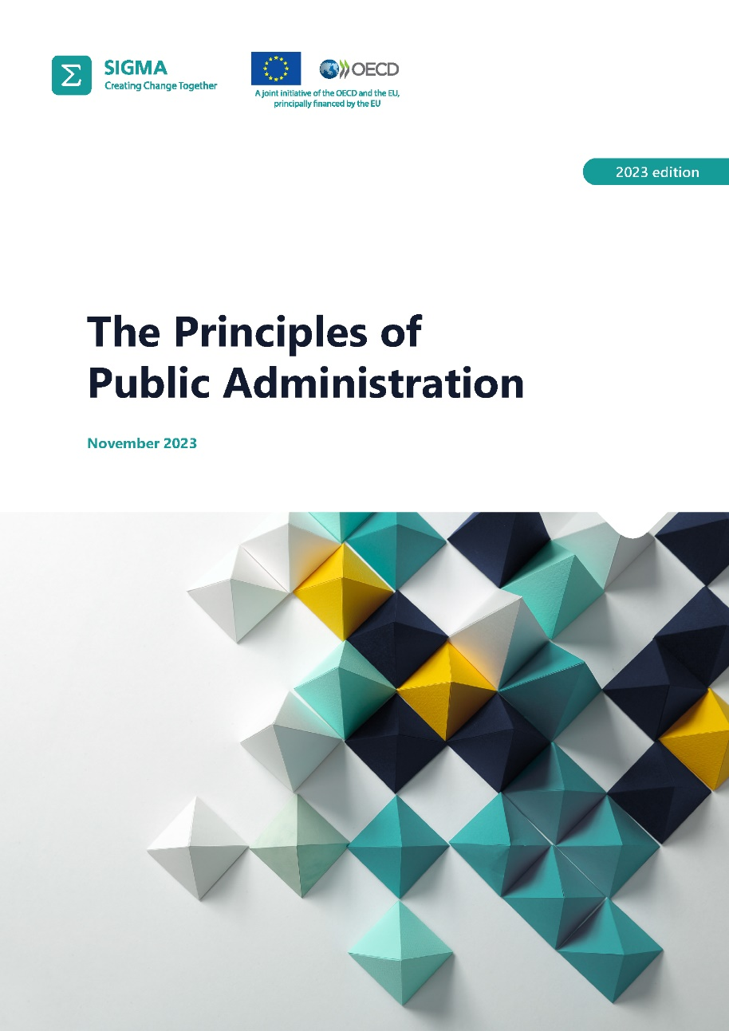
What are the Principles of Public Administration?
A framework of standards defining good public administration.
Produced in collaboration between OECD and EU.
Drafted by SIGMA, a joint initiative of the OECD and the EU
Designed at the request of the European Commission to serve as a tool of EU enlargement and neighbourhood policy.
For the OECD, the Principles serve for dissemination of the Organisation’s good governance standards.
Standards draw on formal EU acquis, OECD recommendations, other international standards and good practices of EU and OECD Members.

Slide 3
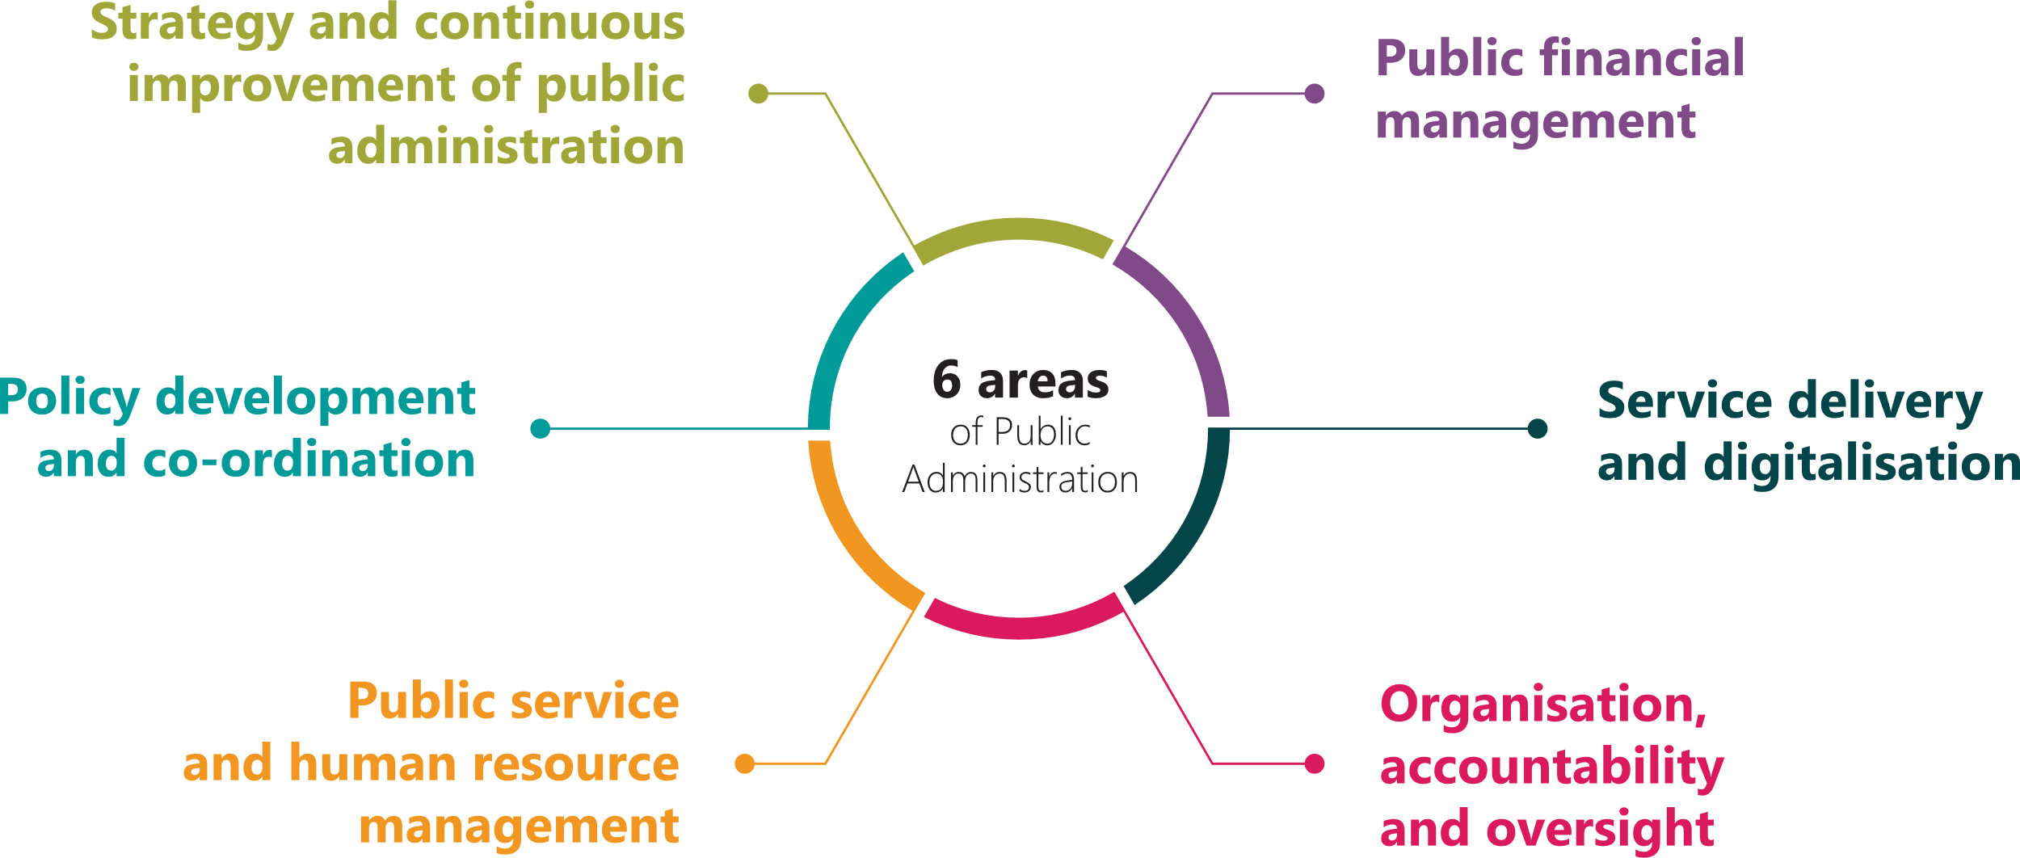
Thematic areas
Policy development and co-ordination
Centre-of-government
Policy planning
Policy making
Consultation
Policy implementation and evaluation
Parliamentary scrutiny
Strategy of continuous improvement of public administration
Public service and human resource management
Service delivery
and digitalisation
Employment framework
Recruitment
Top managers
Motivation and working conditions
Professional development, performance and
talent management
Users at the centre
Streamlined, quality services
Accessibility
Digitalisation
Organisation, accountability and oversight
Public financial management
Budget formulation
Budget execution
Budget reporting
Internal audit
Internal control
Procurement laws
Procurement operations
PP review
External audit
MLG-Fiscal autonomy

Slide 4
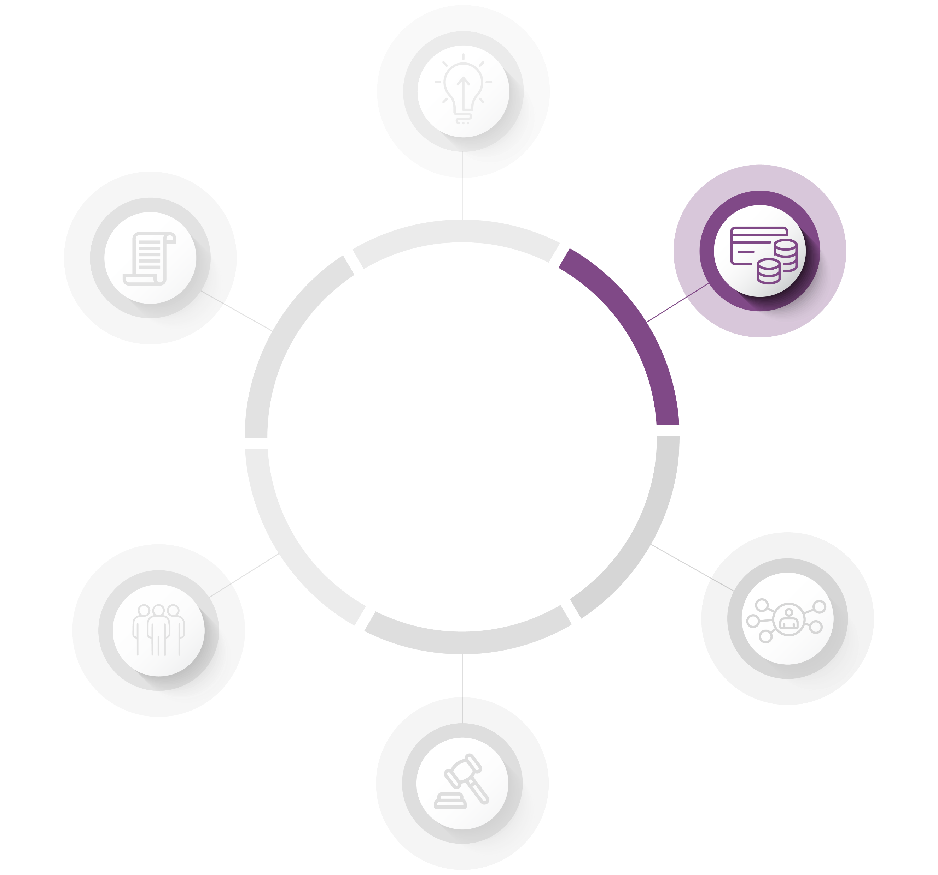
Public financial management
Principles 23-25
Budget management
Management and internal control
Internal audit
Public procurement
External audit
Financing of regional
and local governments
Principle 26
Principle 27
Principle 28-30
Principle 31
Principle 32

Slide 5
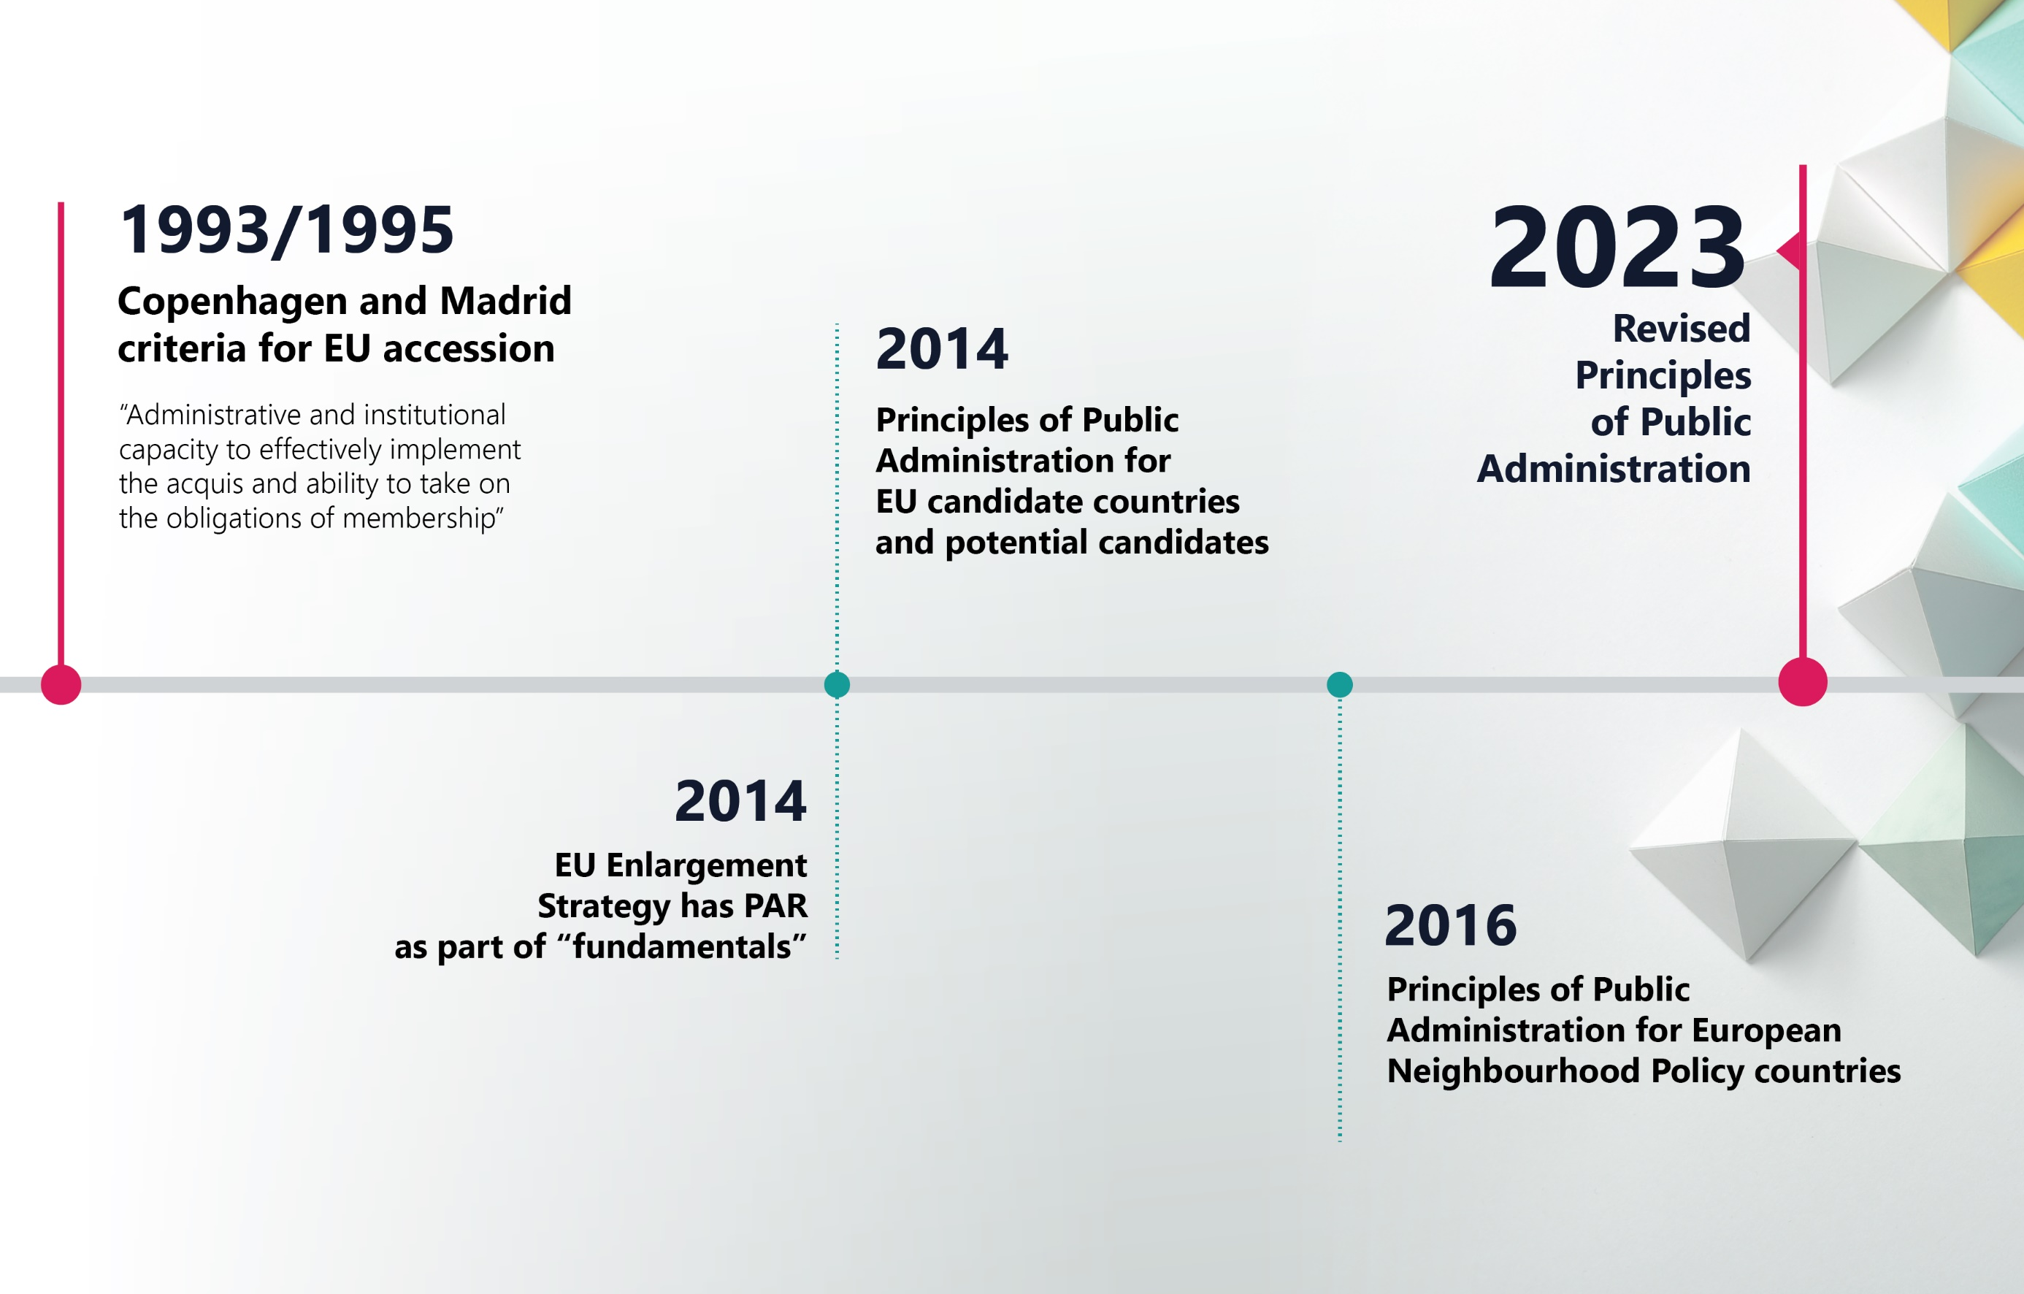
The timeline of the Principles of Public Administration

Slide 6
SIGMA Assessment Projects
2021 – Albania, BiH (partial), Kosovo, Montenegro, North Macedonia, Serbia
2022 – BiH (2nd part)
Spring 2023 – Moldova, Ukraine
Summer 2023 – New PAR Principles formally adopted
Autumn 2023 – New Methodological Framework (indicators)
As of January 2024 – Albania, BiH, Kosovo, Montenegro, North Macedonia, Serbia

Slide 7
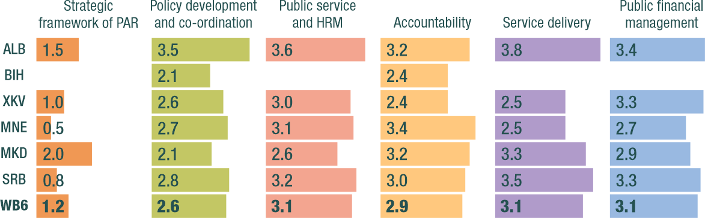
SIGMA assessment of Western Balkan Administrations 2021

Slide 8
Public Procurement Principles
6.10 Public procurement regulations (including PPPs/concessions) are harmonised with the EU acquis.
6.11 There is central institutional capacity to develop, implement and monitor procurement policy.
6.12 The remedies system is aligned with the EU standards of independence and transparency and provides for rapid and competent handling of complaints.
6.13 Public procurement operations comply the principles of equal treatment and transparency and ensure the most efficient use of public funds.
6.14 Contracting authorities and entities have the appropriate capacities and practical guidelines and tools to ensure professional management of the full procurement cycle.

Slide 11
Legislation
There have been a number of developments in the region as regards to public procurement since 2017
Principle 6.10 scoring: 3.16 (2017) – 4.16 (2021)
New strategic policy instruments have been adopted, and legal frameworks have significantly improved and are now mostly harmonised with EU requirements (including defense and utilities)
PPPs/concessions still needs to be harmonized with international standards
Regress noted: special regulations adding exemptions
Recommendations
  Harmonisation of public procurement legislation (including Public Private Partnerships and concessions) with the EU legislation should be completed;
  Review/abolishment of special regulations

Slide 12
Institutional capacity
Scoring for principle 6.11: 3.33 (2017) – 3.83 (2021)
The institutional set-up (classical procurement) is solid and mature, but often understaffed
Central capacity for PPPs/concessions weak and fragmented
Electronic procurement tools are well developed and widely used
Recommendations:
  While acknowledging the need for independence, the central procurement institutions (including the review bodies and state audit) need to establish permanent and efficient mechanisms to co-ordinate interpretation of procurement legislation;
  The central procurement institutions (including those for PPPs and concessions) should be properly resourced to be able to satisfactorily perform all their statutory functions;

Slide 13
Review systems
Principle 6.12 scoring: 3.33 (2017) – 4.17 (2021)
Independent review systems, in line with international standards, are in place.
Significant number of appeals submitted proves trust to the review system
Decision making process are often long, especially at the judicial level.
Quality of rulings of review bodies is uneven
Recommendations:
  Transparency of the review process should be enhanced (in particular to improve smart on-line access to decisions of the review bodies).

Slide 14
Number of appeals submitted to PRBs

Slide 15
Public procurement operations
Principle 6.13 scoring: 1.83 (2017) – 2.33 (2021)
Overall low quality of procurement operations
Competitive procedures widely used, but noted increase of non-competitive procedures
Open tender most often used, multi-stage procedures rarely used
Price-only as the dominant criterion for contract award
Low (and not growing) number of bids submitted per tender

Slide 16
Average number of bids per procedure 2016-2021

Slide 17
Support to contracting authorities and business (professionalisation)
Principle 6.14 scoring: 3.16 (2017) - 2.33 (2021)
Support to contracting authorities and economic operators is insufficient.
There is a need to update training materials following a significant update of procurement regulations.
Comprehensive and updated public procurement manuals, covering all stages of the procurement process and addressing in a practical and useful way the real-life issues identified by stakeholders, need to be produced;

Slide 18
Principles of Public Administration 2023 vs. 2014
Main changes
Improved, but not revolutionised and still recognisable
Updated in line with new EU and OECD standards,
new realities and implementation experience
More focus on emerging topics: innovation, digitalisation,
open data, flexible work arrangements etc.
Multi-level governance included
Less prescriptive, more values-based
More practice and results-focused
Easier to understand, better balance across whole framework

Slide 19

