Slide 1
Trade and Digital Procurement
Nadia-Ariadna SAVA
Early Stage Researcher, SAPIENS Network
PhD Student, Babeș-Bolyai University, Romania
nadia.sava@ubbcluj.ro
This project has received funding from the European Union’s Horizon 2020 research and innovation
programme under the Marie Skłodowska-Curie grant agreement No 956696.

Slide 2
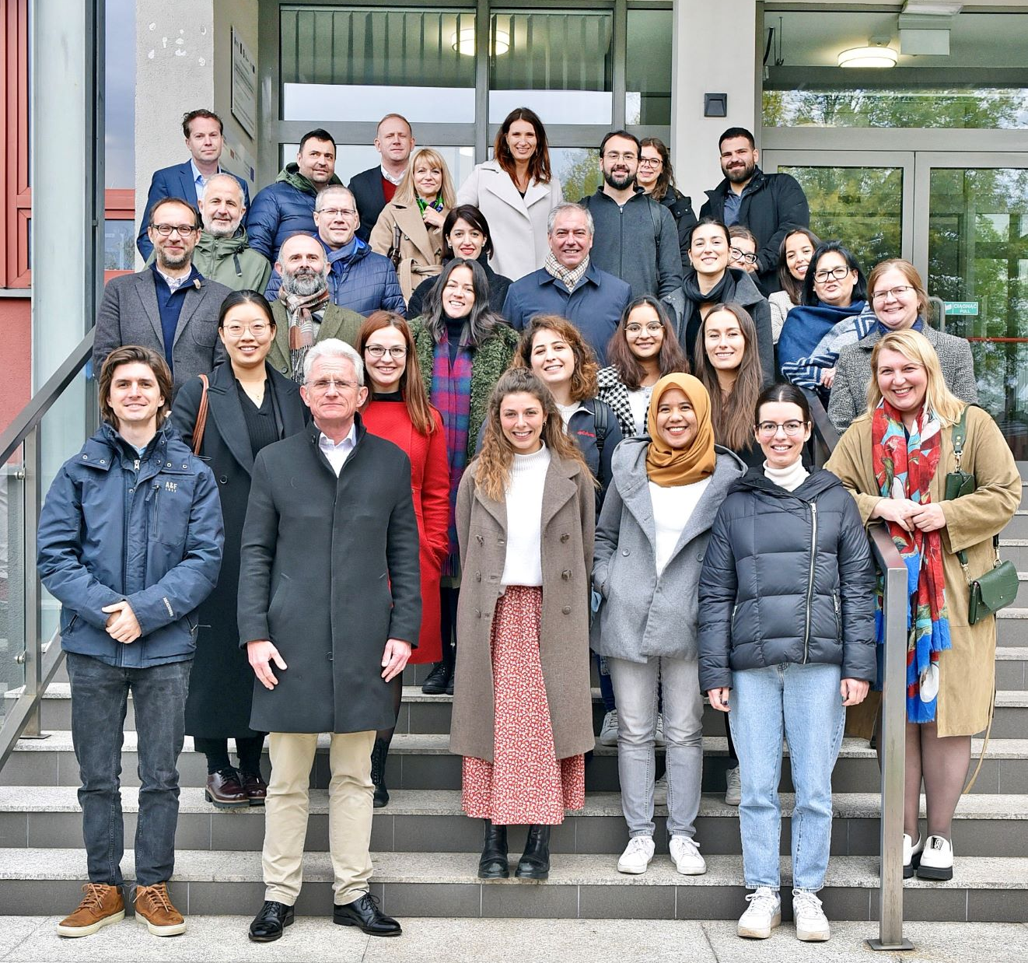
PhD Student & Research Assistant
Sustainable Public Procurement and Digitalisation
https://sapiensnetwork.eu/
This project has received funding from the European Union’s Horizon 2020 research and innovation
programme under the Marie Skłodowska-Curie grant agreement No 956696.

Slide 3
Overview
Part 1
Public Procurement Digitalisation
Part 2
Public Procurement and AI
Part 3
Digital and Sustainable Public Procurement
This project has received funding from the European Union’s Horizon 2020 research and innovation
programme under the Marie Skłodowska-Curie grant agreement No 956696.

Slide 4
Public procurement
Digitalisation
Sustainability
Main
concepts
SPP
This project has received funding from the European Union’s Horizon 2020 research and innovation
programme under the Marie Skłodowska-Curie grant agreement No 956696.

Slide 5
Part 1:
Public Procurement Digitalisation,
incremental or revolutionary?
This project has received funding from the European Union’s Horizon 2020 research and innovation
programme under the Marie Skłodowska-Curie grant agreement No 956696.

Slide 6
1. Digital as disruptive – a revolutionary approach
EC: ‘PP is undergoing a digital transformation. The EU supports the process of rethinking PP process with digital technologies in mind. This goes beyond simply moving to electronic tools; it rethinks various pre-award and post-award phases’
Literature and policy: Exponential growth Case studies: Various pilots (EC, ‘Study on up-take of emerging technologies in public procurement’ (2019))
General literature: Highlights the potential
This project has received funding from the European Union’s Horizon 2020 research and innovation
programme under the Marie Skłodowska-Curie grant agreement No 956696.

Slide 7
Potential uses of AI in PP – A brief matrix
EC, ‘Study on up-take of emerging technologies in public procurement’ (2019):
Analysis and evaluation – procurement data, government spending
Identification of corruption
Contract preparation and management
Chatbots
Further automation of procurement tasks
WB, ‘Disruptive technologies in PP’ (2021):
Automation of low value-added tasks in the public tendering and contract execution
Enhance contract management
Improve accuracy of strategic decisions
This project has received funding from the European Union’s Horizon 2020 research and innovation
programme under the Marie Skłodowska-Curie grant agreement No 956696.

Slide 8
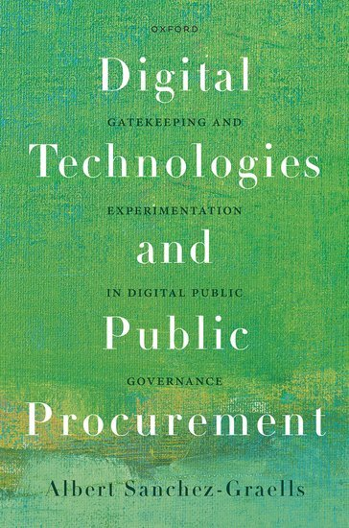
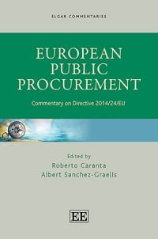
2. Digital as sequential – an incremental approach
Albert Sanchez-Graells (« The Technological Promise of Digital Governance », 4.)
Digitalization as a ‘complementary of, or a stretch of e-procurement (…), capable of making a gradual and additive (non-transformative) contribution to governance’ .
Petra Ferk and Boštjan Ferk
(‘Article 22' in Caranta, R. and Sanchez-Graells, A. (Eds.), Commentary on Directive 2014/24/EU)
Digital technologies build on the pre-existing systems of electronic PP:
paper – e-procurement – digital – data analytics and AI
This project has received funding from the European Union’s Horizon 2020 research and innovation
programme under the Marie Skłodowska-Curie grant agreement No 956696.

Slide 9
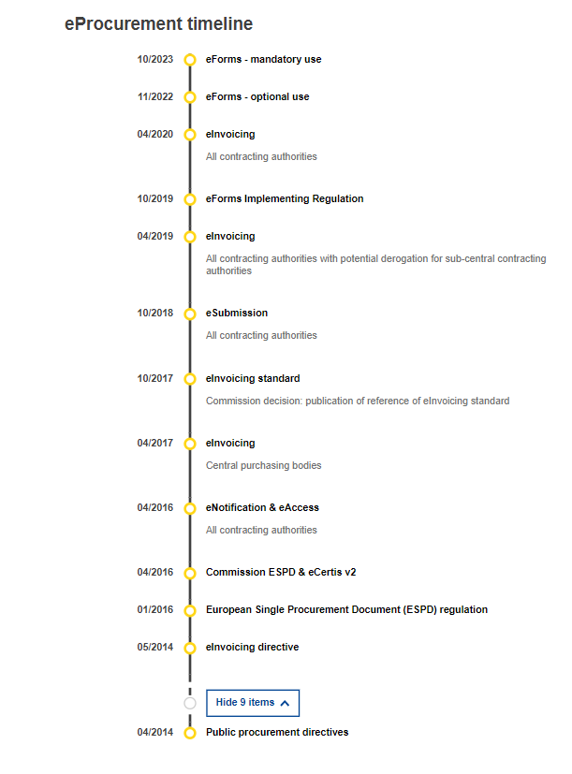
e-Procurement as pre-condition for digital procurement
process of adoption
benefits + challenges in implementation
incomplete and varied transposition in MS
Melon and Spruk (2020):
Success is dependent on implementation
Improvement / deterioration of ‘institutional quality’
https://single-market-economy.ec.europa.eu/single-market/public-procurement/digital-procurement_en
This project has received funding from the European Union’s Horizon 2020 research and innovation
programme under the Marie Skłodowska-Curie grant agreement No 956696.

Slide 10
Conclusion
Learn from the transition to e-Procurement
Rely on the current legal and managerial framework of e-Procurement + build on it
Digitalising public procurement is (and should be) sequential:
e-Procurement
Data infrastructure
Digital technologies
This project has received funding from the European Union’s Horizon 2020 research and innovation
programme under the Marie Skłodowska-Curie grant agreement No 956696.

Slide 11
Part 2
Public Procurement and AI
This project has received funding from the European Union’s Horizon 2020 research and innovation
programme under the Marie Skłodowska-Curie grant agreement No 956696.

Slide 12
Potential uses of AI in PP?
Risks of using AI in PP?
EC, ‘Study on up-take of emerging technologies in public procurement’ (2019):
Analysis and evaluation , identification of corruption, Contract preparation and management, Chatbots, Further automation of procurement tasks
WB, ‘Disruptive technologies in PP’ (2021):
Automation of low value-added tasks in the public tendering and contract execution, contract management , Improve accuracy of strategic decisions
+ Literature
WB (2021)
- legal, technical and management challenges
- Data collection, quality and classification - lack of data, erroneus or conflicting data
Personal data, intellectual, industrial and commercial property, fundamental principles of PP
Sanchez-Graells (2023):
Legal
Compliance w/data governance requirements
Intellectual property rights
Operational
Technical Debt
Cybersecurty
Digital skills shorttage
This project has received funding from the European Union’s Horizon 2020 research and innovation
programme under the Marie Skłodowska-Curie grant agreement No 956696.

Slide 13
AI in PP Assessment
advantages outweigh risks / lower + mitigate risk
technology is mature enough
its integration is gradual + organic
Currently, the conditions are not met
Legal framework + practice – not fit
Prerequisite: A data infrastructure + its legal framework
Standardisation, top-down and bottom-up approach
e-Procurement – data – AI
This project has received funding from the European Union’s Horizon 2020 research and innovation
programme under the Marie Skłodowska-Curie grant agreement No 956696.

Slide 14
Part 3:
The Nexus Between
Digital and Sustainable Public Procurement
This project has received funding from the European Union’s Horizon 2020 research and innovation
programme under the Marie Skłodowska-Curie grant agreement No 956696.

Slide 15
Monitoring Sustainable Public Procurement
Monitoring sustainable public procurement = uptake of SPP
Benchmarking
Data-based policy making
Lack of reliable monitoring
Low adoption of SPP
This project has received funding from the European Union’s Horizon 2020 research and innovation
programme under the Marie Skłodowska-Curie grant agreement No 956696.

Slide 16
SPP Data Monitoring Feedback Loop
Planning
Award procedure
Post-award
Set green and
social indicators
Check indicators
Identify problems
This project has received funding from the European Union’s Horizon 2020 research and innovation
programme under the Marie Skłodowska-Curie grant agreement No 956696.

Slide 17
E.g.: Lithuanian live dashboard for monitoring green PP
Source: https://vpt.lrv.lt/lt/svieslente
This project has received funding from the European Union’s Horizon 2020 research and innovation
programme under the Marie Skłodowska-Curie grant agreement No 956696.

Slide 18
Key Takeaways
PP and Digitalisation: Digitalising PP is (and should be) sequential
PP and AI: Risks outweigh advantages, AI is not fit for the current legal framework + practice
PP Digitalisation and Sustainability: SPP Data Monitoring could lead to the uptake of sustainability
This project has received funding from the European Union’s Horizon 2020 research and innovation
programme under the Marie Skłodowska-Curie grant agreement No 956696.

Slide 19
THANK YOU
Nadia-Ariadna SAVA
Early Stage Researcher, SAPIENS Network
PhD Student, Babeș-Bolyai University, Romania
nadia.sava@ubbcluj.ro
This project has received funding from the European Union’s Horizon 2020 research and innovation
programme under the Marie Skłodowska-Curie grant agreement No 956696.

