Slide 1

EBRD GPA
Technical Cooperation Facility
WTO GPA accession and in-force commitments of the Republic of Moldova
Dorina Harcenco, PhD
EBRD GPA TC Facility
Chisinau, Moldova, 17 November 2020

Slide 2
WTO GPA
The adoption of the revised text of the WTO GPA in 2012, (in force - 6 April 2014), motivated a number of countries to consider accession to the WTO GPA as a step in their reform process.

Slide 3
Example of text slide
Main elements of GPA
National treatment and non-discrimination
Detailed provisions on procurement process, to ensure transparent and open competition.
Enforcement: provisions on application of the WTO-DSU and domestic review procedures
S&D and other provisions to facilitate accession

Slide 4
Moldova has joined the WTO GPA on 14 July 2016 – 47 Party
August 2012
National GPA Seminar in Moldova (support of WTO, EBRD, UNDP, SIGMA)
Feb. 2013
May 2013
Substantive negotiations on Moldova’s revised offer
January 2015
Moldova’s final offer circulated
2000
Moldova submits application to join GPA
3 July 2015
Parliament of Moldova adopted the new law on PP
September 2012
Moldova’s first revised offer circulated together with updated checklist of issue
14th July 2016
Moldova has become a GPA member
2002
2008
2012
2013-2014
2015
2016
2008
Moldova has submitted the initial coverage offer
January 2014
Moldova’s third revised offer circulated
2nd June 2016
Moldova’s Parliament ratified GPA
16 September 2015
Moldova’s accession terms approved.
June 2014
Moldova’s fourth revised offer

Slide 5
Republic of Moldova’s commitments, thresholds, SDR
COUNTRY | ANNEX 1 |  |  | ANNEX 2 |  |  | ANNEX 3
 | Goods | Services | Construction services | Goods | Services | Construction services | Goods | Services | Construction services
Moldova | 130,000* | 130,000* | 5,000,000 | 200,000* | 200,000* | 5,000,000 | 400,000* | 400,000* | 5,000,000
Annex 1: Central government entities
Annex 2: Sub-central government entities
Annex 3: All other entities which procure in accordance with the Agreement, including all legal entities governed by public law and not having an industrial or commercial character and qualified by the Law on PP as contracting authorities, including utilities.
* Two year transition period with higher thresholds applies for Goods & Services purchased by entities included in Annex 1- Annex 3, as follows: Annex 1: 1st year - SDR 300,000, 2nd year SDR 200,000;
Annex 2: 1st year - SDR 400,000; 2nd year - SDR 300,000; Annex 3: 1st year - SDR 600,000, 2nd year -SDR 500,000.

Slide 6
Moldova’s main commitments: (2)
ANNEX 4 - GOODS
1. Unless otherwise specified, this Agreement covers all goods procured by the entities included in Annexes 1 through 3.
2. This Agreement will generally apply to procurement by the Ministry of Defense, Information and Security Service, Border Service or the Ministry of Internal Affairs of non sensitive goods in terms of national security (the list is provided).

Slide 7
Moldova’s main commitments 3
ANNEX 5 - SERVICES
This Agreement covers the following services, which are identified in accordance with the United Nations Provisional Central Product Classification, as contained in document MTN.GNS/W/120 (others being excluded):

Slide 8
List of services:
Description
1. Maintenance and repair services | 20. Management consulting services and related services (except arbitration and conciliation services)
2. Hotel and restaurant services | 21. Architectural services; engineering services and integrated engineering services, urban planning and landscape architectural services; related scientific and technical consulting services; technical testing and analysis services
3. Other land transport services | 22. Advertising services
4. Rental services of sea-going vessels with operator | 23. Placement and supply services of personnel
5. Rental services of non-sea-going vessels with operator | 24. Armoured Car Services
6. Air transport services | 25. Photographic services
7. Travel agencies and tour operators services | 26. Packaging Services
8. Freight transport agency services | 27. Building-cleaning services and property management services
9. Courier services | 28. Other business services
10. Telecommunications services | 29. Services incidental to agriculture, hunting and forestry
11. Financial Services¹ | 30. Services incidental to mining
12. Real estate services | 31. Services incidental to manufacturing
13. Leasing or rental services concerning machinery and equipment without operator | 32. Repair services incidental to metal products, machinery and equipment
14. Other | 33. Primary education services
15. Computer and related services | 34. Secondary education services
16. Legal services | 35. Higher education services
17. Accounting, auditing and bookkeeping services | 36. Adult education services
18. Taxation services | 37. Sewage and refuse disposal; sanitation and similar services
19. Market research and public opinion polling services | 38. Motion picture and video tape production and distribution services
^{[1]} Except contracts for financial services in connection with the issue, purchase, sale or transfer of securities or other financial instruments, and central bank services.

Slide 9
ANNEX 6 - CONSTRUCTION SERVICES
All services listed under Division 51 of the CPC Prov.
Note to Annex 6
Construction services are covered in respect of the Ministry of Defense (Annex 1) only to the extent that such construction services are not related to national security and defense.

Slide 10
Covered Procurement
(GPA Article II:2)
Revised GPA incorporates concept of covered procurement to simplify references to procurement covered under the GPA
Means procurement for government purposes:
  Of goods and services as specified in Moldova’s annexes to Appendix I and not for commercial sale or resale
  By any contractual means, including purchase, lease, and rental or hire purchase, with or without option to buy
  For which the value is estimated to equal or exceed relevant threshold
  By a procuring entity (an entity covered under Moldova’s annexes)
  Not otherwise excluded from coverage.

Slide 11
Republic of Moldova’s PP overview:
Moldovan legislation does not discriminate regarding any foreign bidder

Slide 12
Legal and institutional reform GPA accession. Major changes - new Moldovan PPL (July 2015)
Set up of an administrative Review Body (to avoid conflict of interests);
excluding 100% double ex-ante control for all PP procedures (the same institution approving both the tender documentation before publishing the notice and reviewing and approving the contracts following the procedures);
Extending the min deadlines & including more information in the contract notices.

Slide 13
Legal reform continued:
GPA Accession
Further amendments of the PPL:
- September 2017 - set up of an independent review body.
- July 2018 - amendments -in order to enable the full scale eProcurement.
RM - EU AA

Slide 14
AA and GPA implementation – Latest developments:
It was required a unified procurement regulation for entities from the utilities sector and other state-owned entities covered by Annex 3 of Moldova’s GPA commitments (these entities were obliged to apply GPA provisions directly).
The Law on utilities Nr. 74, was adopted on 21.05.2020, and will enter into force on 20.06.2021.

Slide 15
eProcurement implementation in Moldova
Following GPA accession
MTender has a modern multi- platform architecture, OCDS based and
Full transparency
Moldova is implementing a new electronic public procurement system – MTender: piloted since 2017, mandatory – October 2018
One of its key pillars is that it relies on the golden triangle of collaboration between state, private sector and civil society
All public tenders are accessible online, and every procurement decision is transparently published online in real time.

Slide 16
Moldova’s GPA coverage can be accessed:
https://e-gpa.wto.org/en/Agreement/Latest

Slide 17
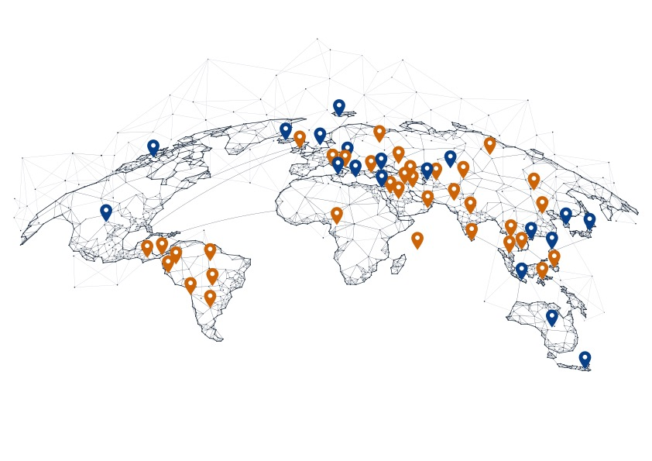
Example of map slide
How and where we work
How and where we work
GPA Parties
GPA Observers
Where we work
• Ukraine, since 2011, joined GPA in 2016
• Moldova, since 2012, joined GPA in 2016
• Armenia since 2014, new text of GPA ratified in 2015
• Montenegro, since 2014, joined GPA in 2015
• Georgia, since 2012
• Tajikistan, since 2014, negotiates final GPA Offer
• The Kyrgyz Republic, since 2014, final GPA Offer
• Azerbaijan, Belarus, Jordan, North Macedonia, Kazakhstan, Turkey initiated in 2016

Slide 18
Conclusions
WTO Accessions lesson: joining earlier is cheaper and will likely yield political and economic extra‐benefits
WTO GPA membership helps preserve the level of reforms, even in unstable political situations
Equal opportunities and equal voting rights to all Parties
Good governance stamp associated with the GPA
generates increased investments and development .

Slide 19
EBRD GPA Technical Cooperation Facility
Supporting countries to achieve transparent, open procurement markets delivering value for money for governments, business and citizens and benefitting from international trade opportunities
EBRD Legal Transition Programme
One Exchange Square,
London EC2A 2JN
United Kingdom
Tel: +44 20 7338 7190
More information: http://ebrd-gpa-facility.com
European Bank for Reconstruction and Development
One Exchange Square
London EC2A 2JN, United Kingdom
www.ebrd.com
World Trade Organization Centre William Rappard
Rue de Lausanne 154 Case postale
1211 Genève 21, Switzerland
www.wto.org

