Slide 1
EBRD UNCITRAL PUBLIC PROCUREMENT INITIATIVE
WEBINAR
“PUBLIC PROCUREMENT COMPLAINTS REVIEW: JUDICIAL SKILLS FOR ADMINISTRATIVE TRIBUNALS”
Procedural fairness in light of main public procurement principles
Caroline Nicholas, UNCITRAL
25 September 2020
9.00-12.30

Slide 2
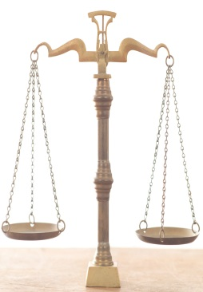
Starting-point – what is procedural fairness?
“The right of a party to be heard and to present arguments to the review proceedings” (EBRD Handbook)
“The right to be heard, to have access to all the proceedings and to present evidence” (UNCITRAL Model Law, article 68)
Including the following rights
Access to a tribunal
To be present at the proceedings
Equality of arms (parties have genuine and equal opportunity to influence outcomes)
To adversarial proceedings
To a reasoned decision

Slide 3
International legal requirements for a review mechanism
United Nations Convention against Corruption
Article 9(1)(d) requires
“An effective system of domestic review, including an effective system of appeal, to ensure legal recourse and remedies in the event that the rules or
procedures [on public procurement] are not followed.”
UNCITRAL Model Law implements these requirements, as set out in EBRD Handbook

Slide 4
Policy reasons for a review mechanism
Part of an effective oversight system
Allows the detection and correction of errors and abuse (so supports key procurement objectives – value for money, avoiding corruption, transparency, competition, objectivity)
Allows law to some extent to be self-policing and self-enforcing
Suppliers have a critical interest in ensuring that the rules are properly followed
Policy Issue 1: The review mechanism will not be effective from these policy perspectives if there is never a change in outcome (to revisit)
Policy issue 2: How to balance the need for an effective review mechanism with the need for the procurement to go ahead/avoiding disruptive complaints? (to revisit)

Slide 5
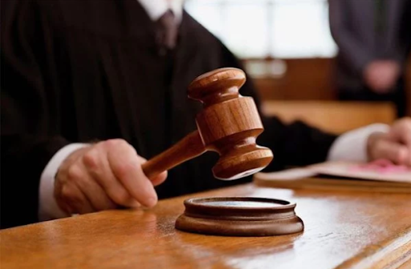
Types of review mechanism
Application for reconsideration
to the procuring entity/contracting authority
Independent, third-party review
by an “independent review body”
Application to the Court
The first is not intended to be an independent review – an opportunity to reconsider its own decision
The second is the first-instance approach taken in Ukraine
With an appeal to a Court

Slide 6
The Tribunal under the LAW OF UKRAINE OF 19 OCTOBER 2019 No. 114 – IX, on Public Procurement
Has a quasi-judicial role
Its members should be independent of the procuring entity, with rules on conflicts of interest
“A member of the Permanent Administrative Board … being a related person to the complainant or to the relevant contracting authority, shall not take part in the review and decision-making process with regard to the complaint in question, and shall be replaced for the period of the review and decision-making with regard to the complaint in question by another State Commissioner of the Antimonopoly Committee of Ukraine to be designated by the Chairman of the Antimonopoly Committee of Ukraine.”

Slide 7
An “effective review mechanism” requires procedural fairness
Issue 1 – scope of the right to review (legal recourse)
• ANY supplier (potential or actual)
• Can challenge ANY decision or action of the procuring entity/contracting authority
• On the basis of non-compliance with rules and procedures of the PP law
• Provisions in Chapter VIII of the UNCITRAL Model Law, supported by other rules and procedures

Slide 8
An “effective review mechanism” requires procedural fairness
Issue 2 – how to exercise the right to review (access to the tribunal)
• To be meaningful
• Before procurement contracts concluded
• Require a standstill period
• Exceptions – limited
• Clear and appropriate rules on when and how a review proceeding can be launched
• Question: How will a supplier learn that there may have been a procedural or other breach of the law?

Slide 9
An “effective review mechanism” requires procedural fairness
Question: How will a supplier learn that there may have been a procedural or other breach of the law?
Key aspect of transparency
Critical role of standstill period
Can identify lack of competition, objectivity in decision-making (UNCAC requirements for a procurement system)
• Advance notices/invitations to participate
• Notice of qualification/disqualification
• Requests for further information
• Clarifications/modifications of procurement documents
• Notice of intention to award the contract
• Contract award notices
• Debriefings

Slide 10
An “effective review mechanism” requires procedural fairness
Issue 3 – how to exercise the right to review (present at the proceedings and equality of arms)
• How to gather appropriate evidence
• Much in hands of procuring entity/contracting authority
• Traceability and justification of steps
• Key role of documentary record of procurement proceedings
Article 25 Model Law – the documentary record
• Supplier and public access
• Before and after notification of winning supplier
• The independent review body has a right of access to the entire record (the procuring entity/contracting authority is legally obliged to provide it)

Slide 11
An “effective review mechanism” requires procedural fairness
Issue 4 – how to exercise the right to review (genuine and equal opportunity to influence outcomes)
• Prompt public notice of review (allows other suppliers to join in, CSOs are informed)
• Avoiding “fait accompli”
• Suspension/prohibition of entering into contract while complaint/appeal is considered
• Presumption in favour
• Exception for urgent public interest considerations

Slide 12
An “effective review mechanism” requires procedural fairness
Issue 5 – meaningful outcomes
• Main aims: corrective action; rapid results
• Prohibition or revision of unlawful actions or decisions
• Annulment/overturn of unlawful decisions or contracts
• Termination of procurement
• Award of costs
• Award of lost profits/loss of a chance as an optional incentive
• Publication of reasoned award

Slide 13
An “effective review mechanism” requires procedural fairness
Issue 6 – balancing procurement needs and review mechanism
• Rapid results
• Time-frame for issue of outcome of initial review and final decision
• Effective links between independent review body and appeal mechanism
• Opportunity to override review mechanism to allow procurement to continue for urgent public interest considerations

Slide 14
Conclusions An “effective review mechanism” requires procedural fairness
• Review mechanism is integral part of public procurement
• Familiarity with public procurement procedures and practice as well as rules
• Preventing unnecessary complaints – debriefings and transparency
• System serves educative function as well as corrective/preventive one

Slide 15
The UNCITRAL Model Law (2011) and Guide to Enactment (2012)
https://uncitral.un.org/en/texts
https://uncitral.un.org/ru/texts
Contact caroline.nicholas@un.org
THANK YOU
24. 9. 2020
15

