Slide 1
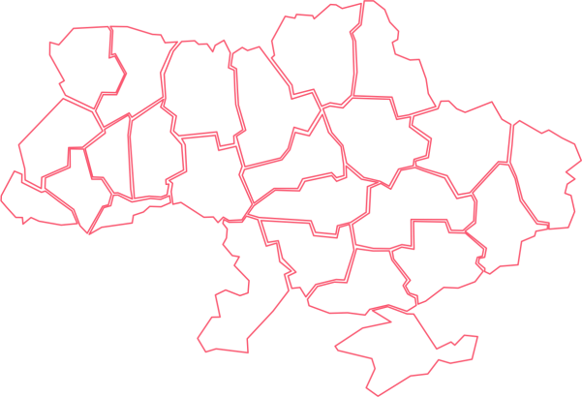
Public Procurement and Sales in Ukraine
Anastasiya Kozlovtseva
Head of International Relations
Transparency International Ukraine

Slide 2
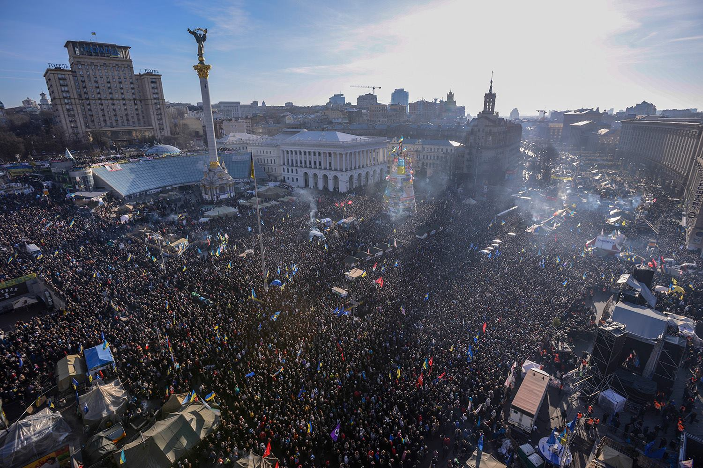

Slide 3
End of Paper Era

Slide 4
PP was seen as synonym of corruption in Ukraine
UAH 30bn (ca $1,2 bn) – conservative estimation of “corruption tax”
10%
10%
10%
10%
UAH 300bn
($12bn)
UAH 30bn (ca $1,2 bn) –
losses caused by limited competition
At least $2,4 bn per annum – losses from corruption and limited competition
Notes:
Use better photo?

Slide 5
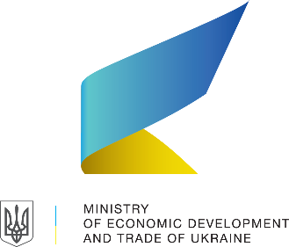
“Golden triangle of partnership” in the core
Government: “the rules”, professionalization and data storage
Civil Society: monitoring and control of procurement
Commercial platforms: CAs & suppliers acquisition and service
Commercial platforms
Notes:
Use better photo?

Slide 6
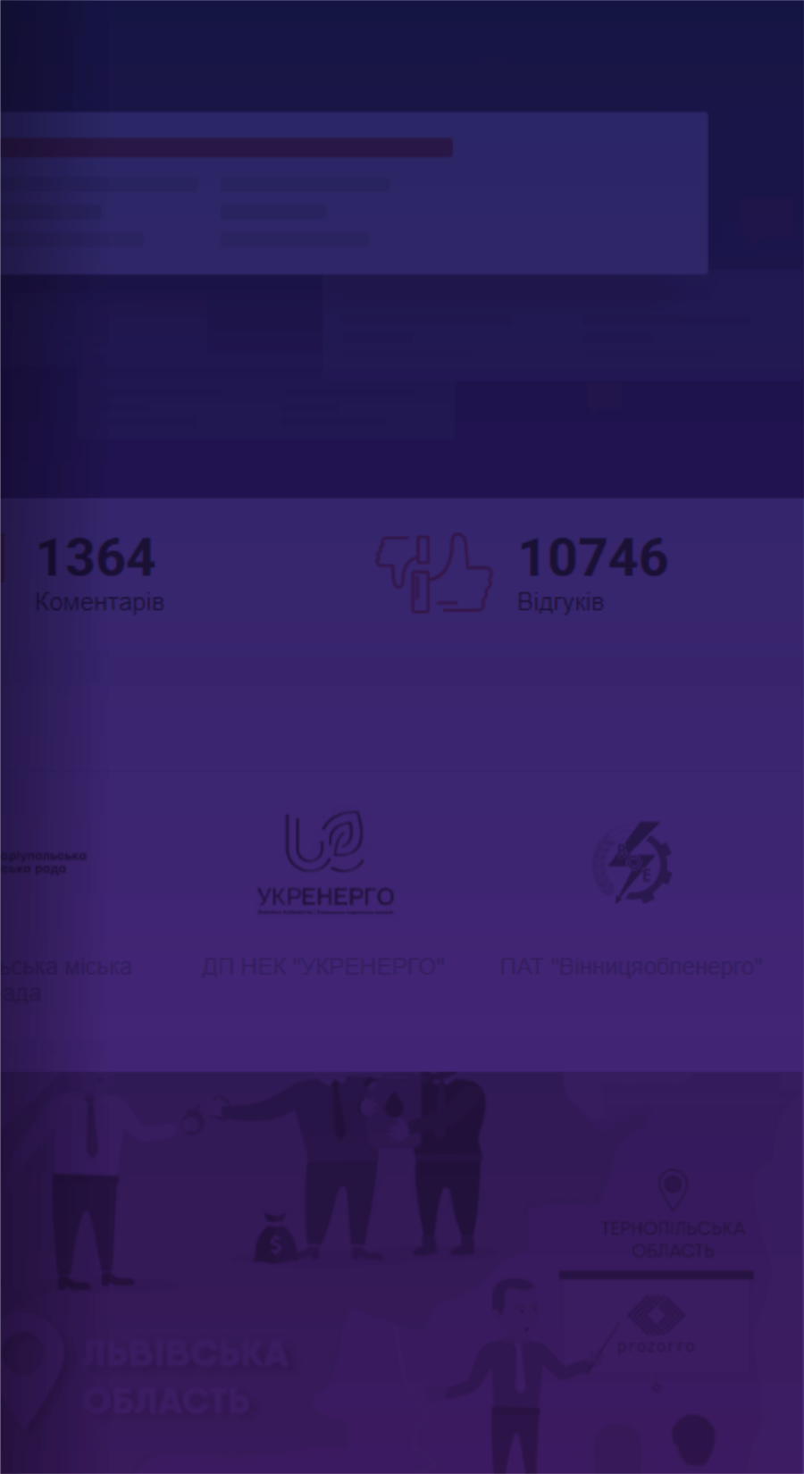
VISION
MISSION
Civic network run by Transparency International Ukraine watching national and regional public procurement
To unite the civil society in watchdog activities to ensure access and fair play among public procurement stakeholders

Slide 7
impact areas
Developing
civic tech for open data to analyse
and to monitor public spending
Providing unique feedback loop on public procurement via dozorro.org
Raising awareness though educational materials and events
A strong civil society community in the regions all over the Ukraine
Training and capacity
building
for watchdog
activists
Giving voice to local stories

Slide 8
DOZORRO-community
Organizations that share our vision and values:
24 civil society organizations
45 representatives of procuring entities and business community

Slide 9
risk indicators
DOZORRO developed innovative data-driven red flags methodology for investigation of risky tenders in 2017
Risk indicator analysis is running on machine learning (2018)
6 unique indicators based on the review status: no response to complaint, negative rank on the provided response, risks mentioned in the feedback, etc.
40 risks indicators overall
6
40
Notes:
2017 - development of the methodology and 44 risk indicators http://risk.dozorro.org/
2018 - launch of the automated risk-monitoring based on the 40 indicators, publicly available, enabling filtering tenders along riskiness criteria

Slide 10
Our achievements
1,5 million unique DOZORRO users | 152 000 users of Open BI | 300 certified professional BI users
more than 30 000 violations identified | more than 35000 appeals to control bodies | 3600 “wins” and 48 opened criminal proceedings
We use open-source open-data OCDS tools and that makes our civic tech highly transferable – DOZORRO-tools are used by NGOs in Moldova and Poland

Slide 11
Our achievements
We are listed in top 12 projects worldwide for citizen watchdogs
DOZORRO was featured by FORBES magazine
We successfully advocated introduction of mandatory risk-based monitoring in Ukrainian government – State Audit Service started a pilot of online public procurement monitoring in 2018 and changes to Law on PP in 2019.
We use open-source open-data OCDS tools and that makes our civic tech highly transferable – DOZORRO-tools are used by NGOs in Moldova and Poland

Slide 12
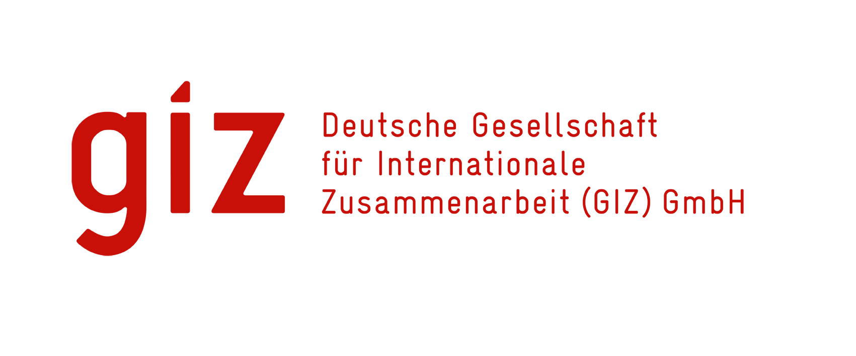
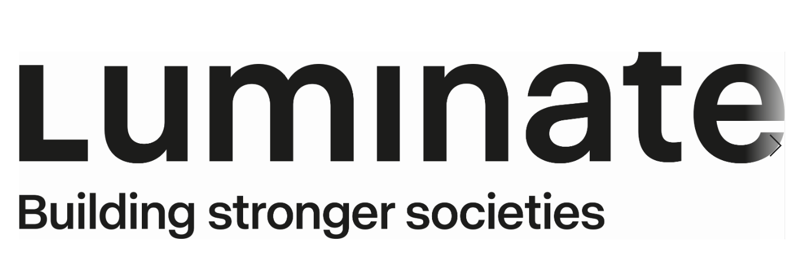
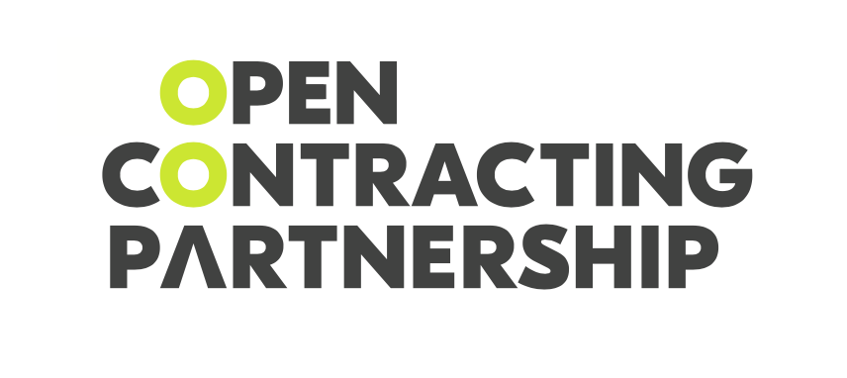
main partners
Notes:
2017 - development of the methodology and 44 risk indicators http://risk.dozorro.org/
2018 - launch of the automated risk-monitoring based on the 40 indicators, publicly available, enabling filtering tenders along riskiness criteria

Slide 13
Thank you! kozlovtseva@ti-ukraine.org

