Slide 1
Krzysztof Izdebski, Daniel Macyszyn
ePaństwo Foundation

Slide 2
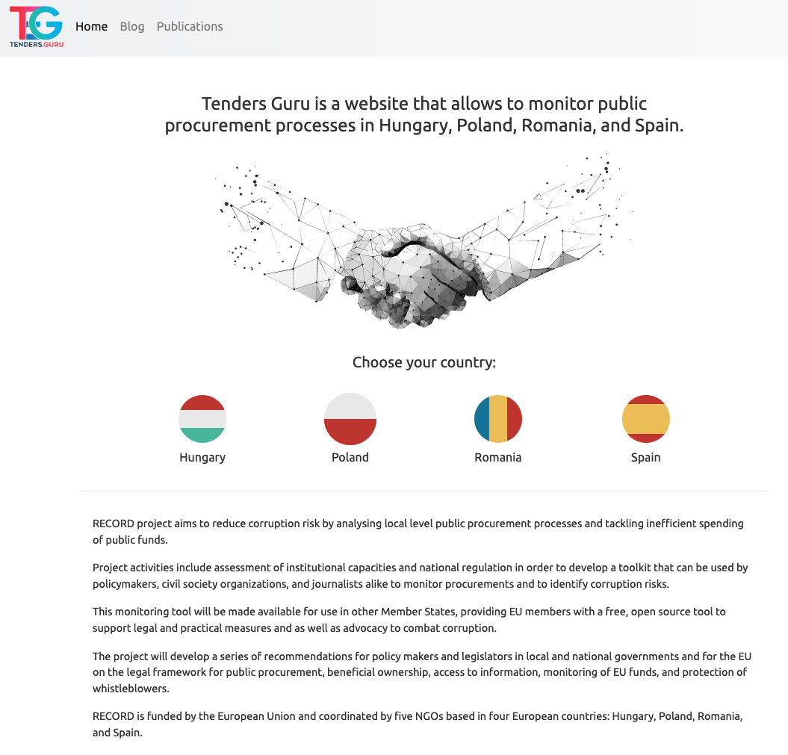

Slide 3
National subportals consists of three areas:
Home / Risk indicators
Tenders
Tender’s page

Slide 4
Home / Risk indicators

Slide 5
Home / Risk indicators
This is a page on which we present risk indicators that we monitor in the scope of the project. In the current state we present data for one indicator: “Short deadline” - more indicators will be published on the portal in the next phase of the project.

Slide 6
Tenders

Slide 7
Tenders
This is a page that allows users to search our repositories of public procurements. It features:
Full text search Our search engine has been adjusted to work with content in 4 languages:
Hungarian
Polish
Romanian
Spanish
Filtering Users can narrow their search results by criterias such as type of procurement or its category.

Slide 8
Tender’s page

Slide 9
Tender’s page
Tenders pages were designed with a purpose of making it easier for citizens to understand procurement process. They use modern user interface with lightwave infographics and interactive tools for reading source documents (mostly in PDF formats).

Slide 10
What next?
Next features of the tool that will be added in the next phase of the project include:
More risk indicators presented and explained.
More powerful full text search by adding source documents to what’s searched on.
More data visualization on tenders pages.
Matching with company registries.

Slide 11
Risk Indicators
Below Threshhold/Total
Close to Threshold (2 versions: for below threshold and for below EU threshold)
Similar Contracts same company (2 versions: for below threshold and for below EU threshold)
Concentration (% awarded to 1 company)
Time - Short Bidding period
Time - Duration of contract too long
Estimate cost vs. awarded
Procedures (open tender vs others such as)
Unsuccesfull procurement

Slide 12
Risk Indicators

Slide 13
Company Register (https://rejestr.io/)

Slide 14
https://tenders.guru/
krzysztof.izdebski@epf.org.pl
daniel.macyszyn@epf.org.pl

