Slide 1
ONLINE OPEN CONTRACTING DATA STANDARD CONTRACT REGISTER
Dmitry Palamarchuk- eProcurement expert, Business analyst
London 12th March 2020

Slide 2
Contract Register – What is it?
“A public contract registry is an online repository that aims at keeping track of all procurements concluded by the state and making this information available online, thereby providing a basis for monitoring the way in which public money is spent. Establishing contract registries can be a powerful tool to highlight the way in which taxpayers’ money is used.”
https://ec.europa.eu/regional_policy/sources/good_practices/GP_fiche_23.pdf

Slide 3
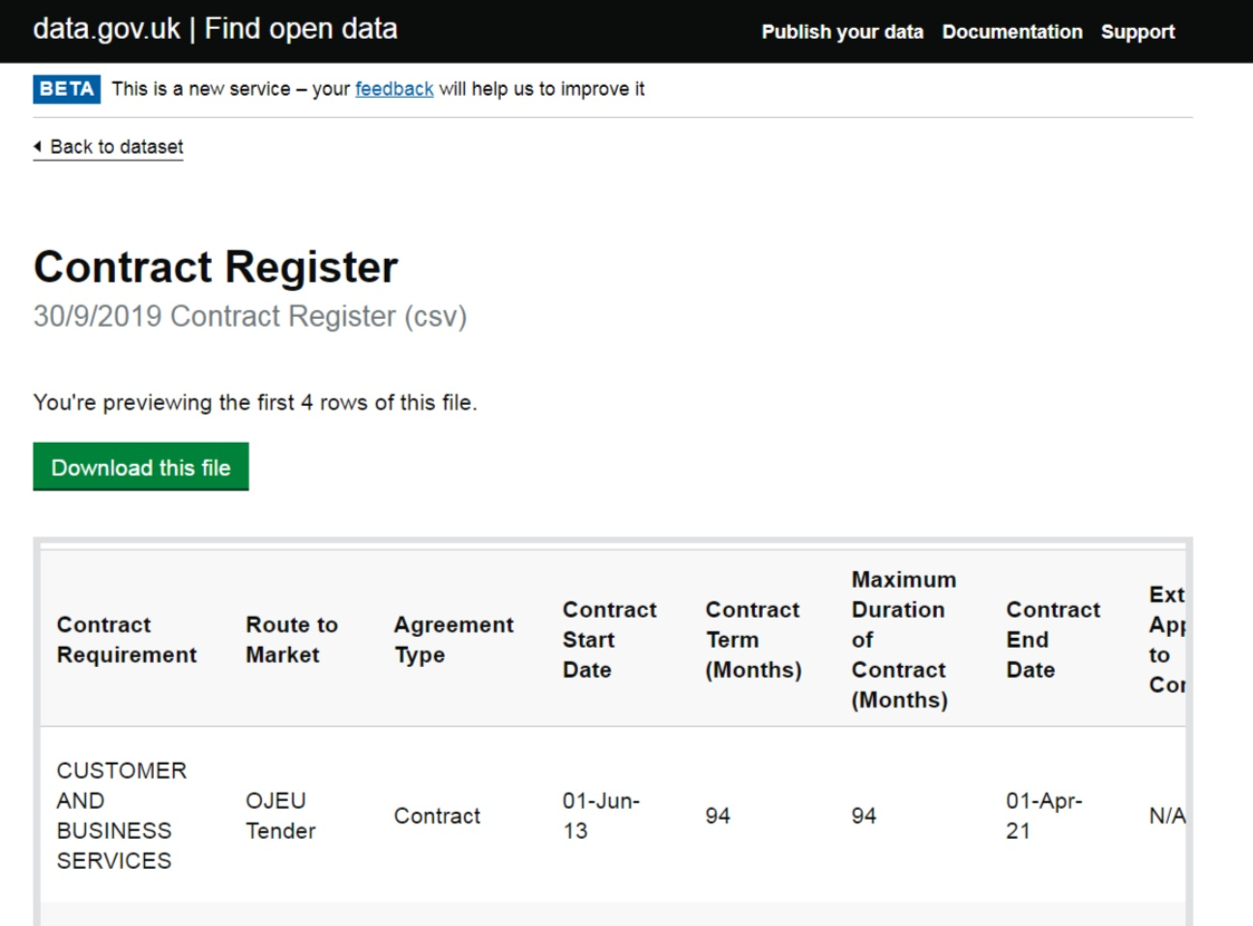
How do existing Contract Registers look like?

Slide 4
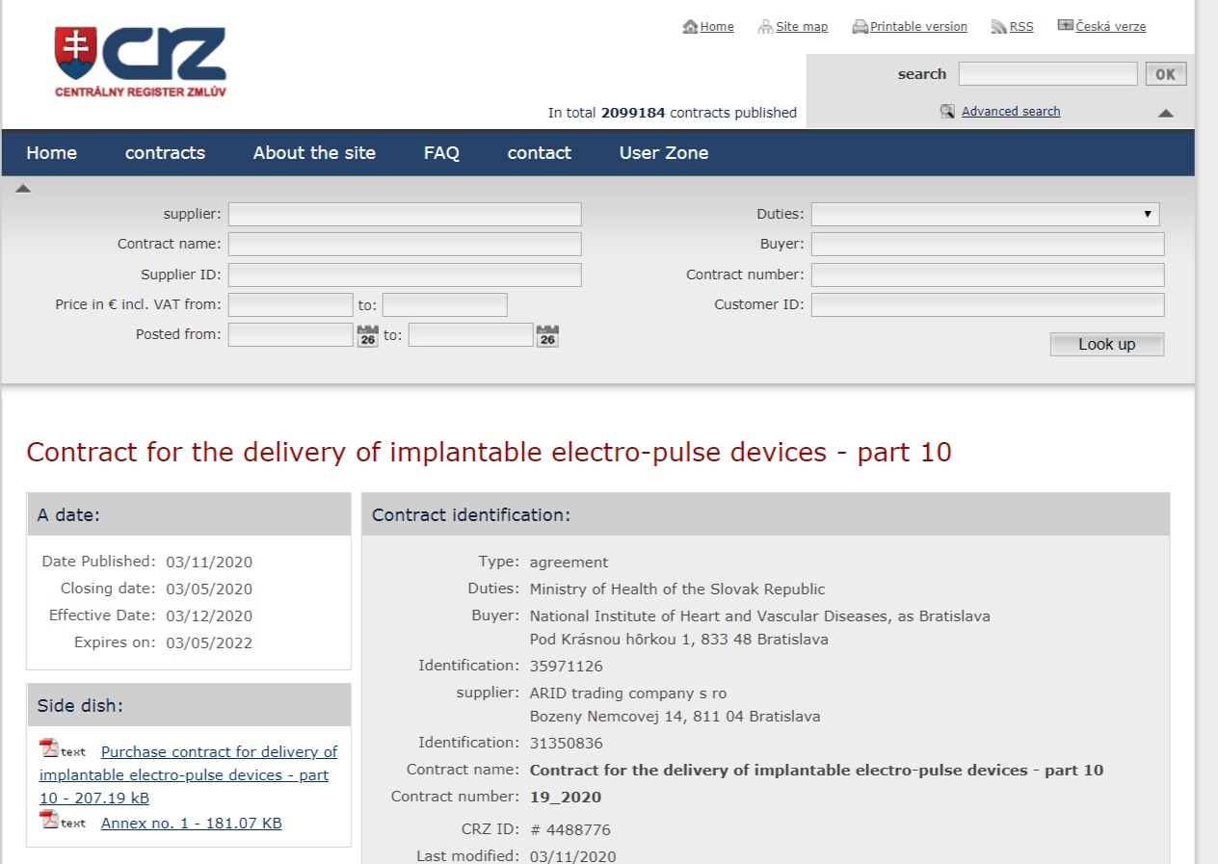
How do existing Contract Registers look like?

Slide 5
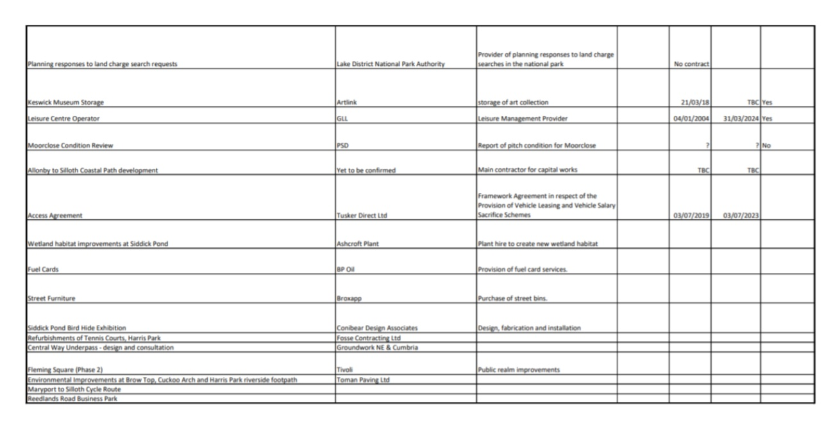
How do existing Contract Registers look like?

Slide 6
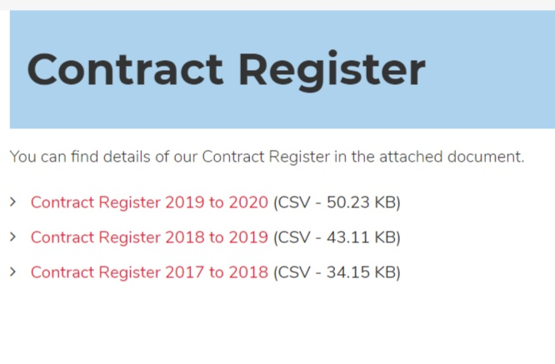
How do existing Contract Registers look like?

Slide 7
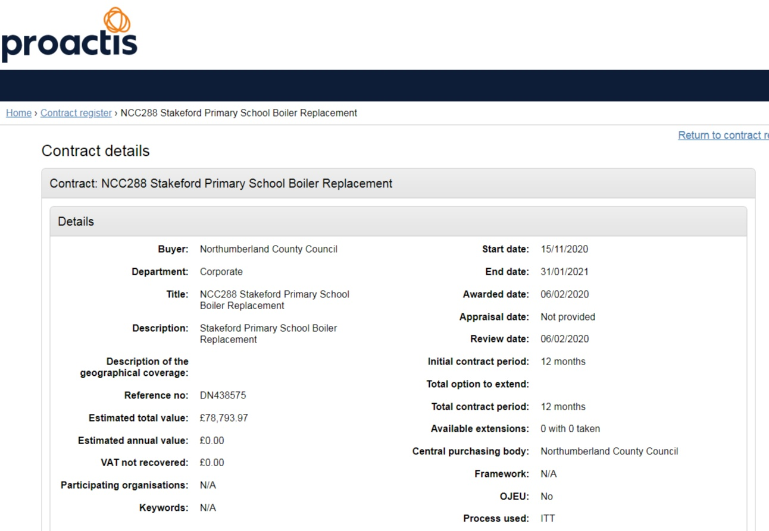
How do existing Contract Registers look like?

Slide 8
What are the current the features?
No up- to- date access to the data;
Very often no filters or search;
No procurement process information;
No budgeting information;
No information on the current status of the contract;
No analytical functions, no quantitative indicators and absence of dashboards.

Slide 9
The current approach does not meet modern requirements to the data accessibility, and it is not sufficient to facilitate transparency as well as establish a real “basis for monitoring the way in which public money is spent.”

Slide 10
Objectives: end-to-end data on every contracting process
Provide up-to-date information on all public procurement contracts in one point of access;
Enable access to the “pre-contract” data to understand the procurement process before a contract;
Enhance the level of digitalization of contract information, obtain more data on a contract itself;
Enable modern access to the current status of a contract;
Ease to find a public procurement contract;
Increase the visibility of the current state of how public money is spent.

Slide 11
Who will benefit most from the registry?
CSO and citizens by better transparency and visibility;
Economic operators by gaining better market understanding;
Municipalities by having the technical means to consolidate and integrate data from multiple sources;
Central Government by the country-wide up-to-date information on procurement contracts.

Slide 12
Main Business Requirements
Consolidated data from all data sources related to the contracting process in one database;
Access to the governmental data via API as open data;
Coherent data interpretation by the various analytical services;
A single point of reference to the contract and its contracting process and contract implementation process;
A way of data integration from different data sources for CAs;
Flexible search, filtering and data visualization combining all data on the contracting process.

Slide 13
Consolidated data sources around Contract using OCDS

Slide 14
Data consolidation and integration

Slide 15
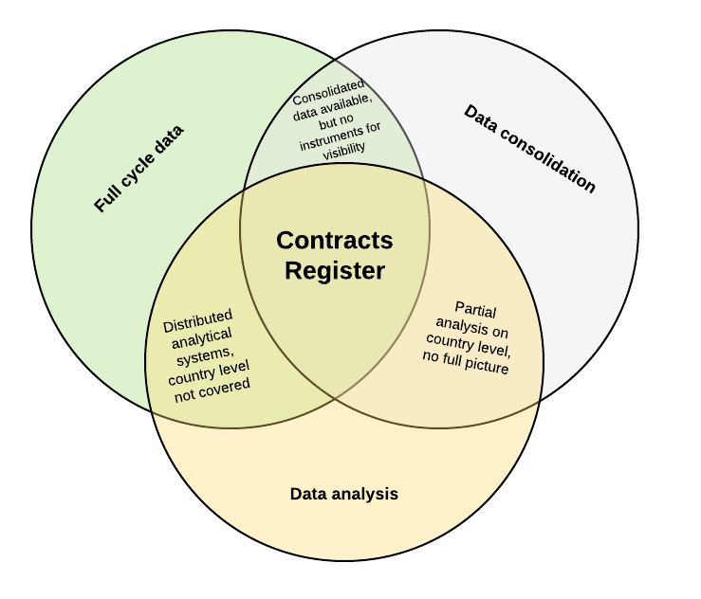
Contracts Register with consolidated end-to-end data supported by the data analysis and visualisation

Slide 16
Contract Register in the transition from system to system

Slide 17
Outcomes of the OCDS based Contracts Register
CAs can easily fulfill policy requirements
Enabled analysis on the regional or country level
Enhanced monitoring and auditing capacity by the single source of data
Single source of open data with data quality checks and coherent interpretation
Enabled market analysis and potentially prices comparison
Enhanced quality of analytical product

Slide 18
For more information, please contact:
Dmitry Palamarchuk
eProcurement expert/Business analyst
Email: dmitry@ppi-ebrd-uncitral.com
Ukraine, Kyiv

